Slide 1

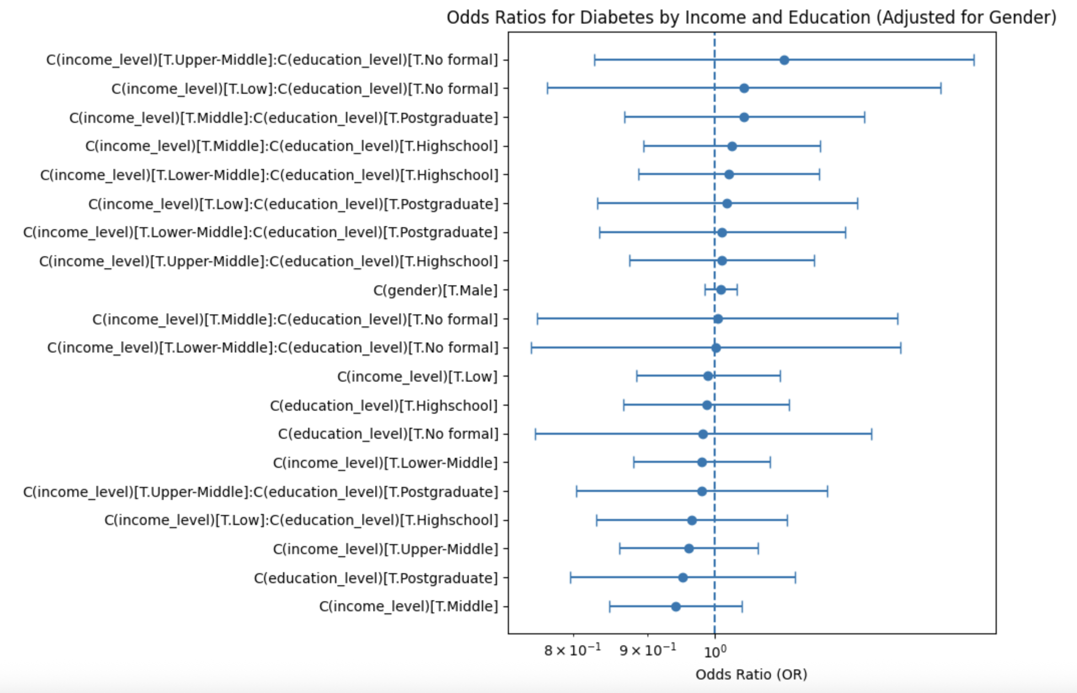
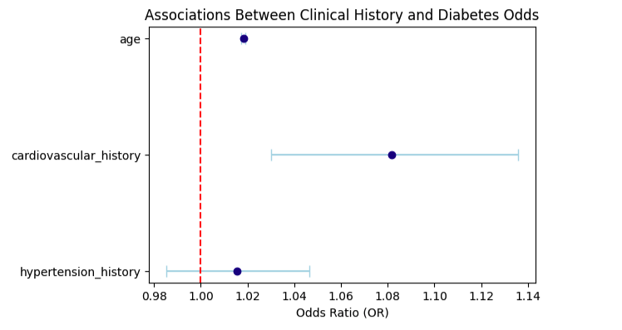
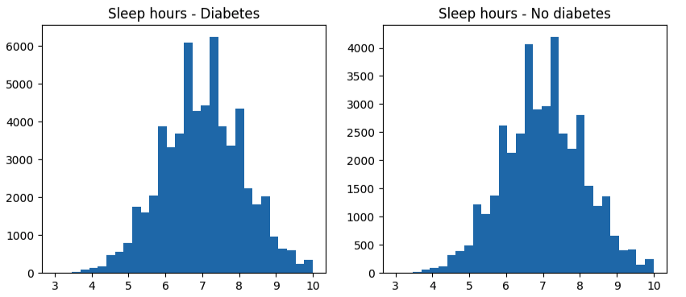
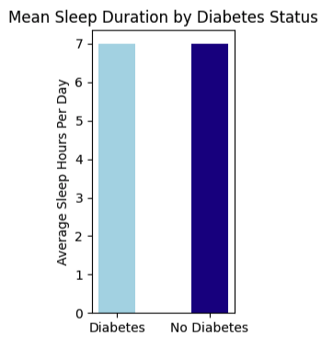
Identifying the Most Informative Predictors of Diagnosed Diabetes: Evidence From a 100,000-Adult Health Dataset
Liping Chen
Rollins School of Public Health – Health Policy
Abstract/Intro/Motivation
Results
Conclusions/Future Directions
What is the central research problem or question you have been helping to explore?
What work has been done previously in this area?
This section can be a review of the literature that has been most important in your research area
Type 2 diabetes is one of the most prevalent chronic diseases worldwide and continues to rise across all age groups. Global estimates show that more than 500 million adults are currently living with diabetes, and the number is projected to reach 643 million by 2030, creating a substantial medical and economic burden on populations and health systems. (1).
Prior research shows that people with higher socioeconomic status (SES) are more likely to achieve controlled HbA1c and meet triple treatment targets, while individuals with lower SES face barriers such as limited healthcare access and unhealthy behavioral patterns(2).
However, it is still unclear how social, behavioral, and clinical factors compare in predicting who is diagnosed with diabetes. To address this gap, this project uses a dataset of 100,000 adults to examine:
whether income, education, and gender relate to diabetes status
whether clinical factors like age and cardiovascular history better predict diabetes
whether sleep duration differs between people with and without diabetes.
This study aims to clarify which predictors are most informative for understanding diabetes risk in a large adult population.
1. Do social factors (income, education, gender) predict diagnosed diabetes?
Findings: The logistic regression model examined income level, education level, their combined effect, and gender as predictors of diagnosed diabetes. The interaction between income and education was not statistically significant, indicating that income and education together were not associated with diabetes status. Across income and education categories, odds ratios were close to 1, and all 95% confidence intervals included 1. Gender was also not significantly associated with diabetes after accounting for income, education, and their interaction (male vs female: p = 0.483).
Conclusion: Overall, social factors showed very limited predictive value for diagnosed diabetes in this dataset. Neither income level, education level, nor their combined effect meaningfully influenced diabetes risk in this sample.
2. Do hypertension history, cardiovascular history, and age predict diabetes?
Findings: Cardiovascular history was a significant predictor (OR = 1.082, CI 1.030 to 1.136, p = 0.002), indicating higher odds of diabetes among individuals with cardiovascular disease. Age showed a strong and consistent association (OR = 1.018, CI 1.017 to 1.019, p less than 0.001), meaning older individuals had higher odds of being diagnosed. Hypertension history was not statistically significant (p = 0.317).
Conclusion: Diabetes risk in this dataset was more strongly linked to clinical history and age, highlighting the importance of medical background in predicting metabolic conditions.
3. Do people with diabetes sleep fewer hours per day?
Findings: The mean sleep duration in the diabetes group was 6.997 hours, and in the non diabetes group 6.998 hours—a nearly identical average. A two sample t test confirmed there was no significant difference between the groups (t = −0.13, p = 0.899). Histograms and bar charts showed overlapping distributions with no meaningful separation.
Conclusion: There was no evidence that diabetes status is associated with fewer hours of sleep.
Finding: Across the three analyses, social factors such as income, education, and gender showed very limited associations with diagnosed diabetes. Neither income level, education level, nor their combined effect meaningfully predicted diabetes risk. In contrast, clinical factors played a much stronger role: individuals with a history of cardiovascular disease, hypertension, or older age had significantly higher odds of being diagnosed with diabetes. Sleep duration did not differ significantly between individuals with and without diabetes, suggesting that shorter sleep alone was not associated with diabetes status in this dataset.
Learning: These findings suggest that demographic and lifestyle factors in this dataset may not be strong predictors of diabetes on their own, while clinical history and age offer clearer signals. This highlights the importance of medical risk profiling over social characteristics when identifying populations at higher risk for diabetes.
Conclusion: Overall, the dataset demonstrates that clinical factors are more informative than social factors or behavioral measures like sleep. Logistic regression models for social variables showed minimal effect sizes and mostly nonsignificant results, whereas models using clinical history identified meaningful associations. The sleep analysis further supports that not all commonly discussed lifestyle factors have measurable effects in this dataset.
Methods/Approach
This study utilized a dataset of 100,000 adults that includes social, behavioral, and clinical information related to diabetes. Key variables included socioeconomic indicators (income level, education level), demographic factors (gender, age), medical history (hypertension and cardiovascular disease), and behavioral measures such as average sleep hours per day. Diabetes status was measured as a binary outcome indicating whether an individual reported a diagnosis of diabetes.
To examine how these factors relate to diabetes, I applied logistic regression models to estimate the association between each predictor and the likelihood of being diagnosed. Odds ratios and 95 percent confidence intervals were used to compare the direction and strength of associations across variables.
To illustrate the results, I presented forest plots showing which social and clinical factors were most strongly linked to diabetes. For behavioral patterns, I compared mean sleep hours between individuals with and without diabetes using a simple statistical test to assess group differences.
Future Directions: Future work could incorporate additional behavioral variables such as diet quality, physical activity, or stress to assess whether more nuanced lifestyle measures influence diabetes risk. It would also be valuable to explore interaction effects (for example, age × hypertension history) or to extend the analysis using longitudinal data to better understand causal pathways. More detailed clinical measurements, such as fasting glucose or BMI, could strengthen predictive modeling in future studies.
Acknowledgements
Source:
(1)United States of America. Diabetes Atlas. (2025, March 20). https://diabetesatlas.org/data-by-location/country/united-states-of-america/
(2)Darvishi, A. (2024, March 30). Socioeconomic inequalities in type 2 diabetes mellitus: A study based on a population-based survey in Iran - BMC Public Health. SpringerLink. https://link.springer.com/article/10.1186/s12889-024-18452-7#Sec2
Data set: Thalla, M. K. (2025, September 21). Diabetes health indicators dataset. Kaggle. https://www.kaggle.com/datasets/mohankrishnathalla/diabetes-health-indicators-dataset

